Slide 1
large scale Refactoring
Volodymyr Fedak

Slide 2
Who Am I
Solution Architect at SoftServe with 9+ years experience in IT
Ongoing project: Significant efforts are dedicated to the following quality attributes: testability, extensibility, maintainability
A lot of efforts are spent on evolving legacy projects

Slide 3
Agenda
Refactoring strategies
Summary
Case study
Why do we change code?
Why refactor?

Slide 4
Four Reasons to Change Software
Adding a feature
Fixing a bug
Improving the design
Optimizing resource usage

Slide 5
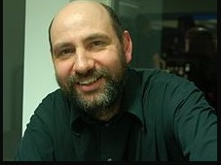
Any fool can write code that a computer can understand. Good programmers write code that humans can understand

Slide 6
What is not refactoring
Refactoring is not debugging
Refactoring is not performance
Refactoring is not adding a feature

Slide 7
What is refactoring?
"Refactoring is a disciplined technique for restructuring an existing body of code, altering its internal structure without changing its external behavior."

Slide 8
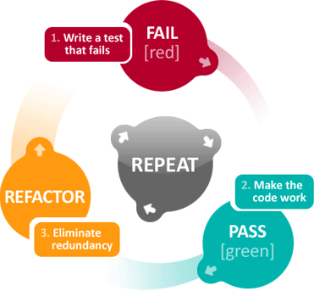
Refactoring is an continuous process

Slide 9
What is large scale refactoring?
Restructuring of existing code that has visible influence to the overall system quality attributes.

Slide 10
Agenda
Refactoring strategies
Summary
Case study
Why do we change code?
Why refactor?

Slide 11
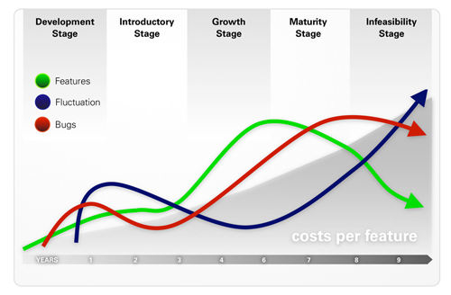
Success projects statistics

Slide 12
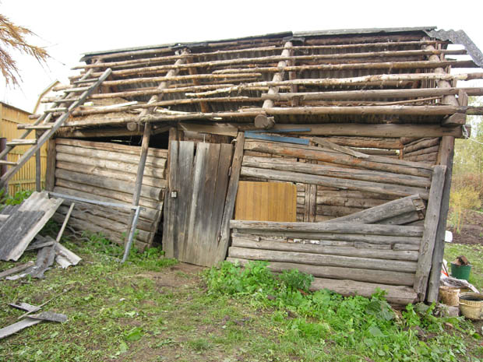
Legacy projects: technical perspective

Slide 13
Legacy projects team policies and practices
They minimize the number of changes that they make to the code base
Sometimes this is a team policy: "If it's not broken, don't fix it”
Developers
What? Create another method for that? No, I'll just put the lines of code right here in the method, where I can see them and the rest of the code. It involves less editing, and it's safer

Slide 14
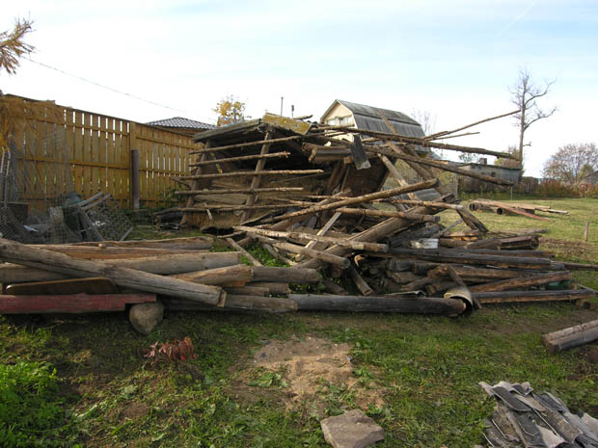
After such policy

Slide 15
Refactoring helps
Improve code quality. You Can’t be Agile if your code sucks!
Make the code easier to understand
Make it easier to maintain codebase
Refactoring reduces your risk—can lead to lightweight
pragmatic design

Slide 16
Refactoring principles
Rely on automated tests
Don’t write code that’s really not needed, Code you don’t write, don’t have to be maintained!
Avoid Clever Code—Keep it Simple
Keep code DRY

Slide 17
Refactoring principles
Make code self documented
Checkin Frequently, take small steps
Make sense in seconds, not in minutes, hours, weeks, ...

Slide 18
Agenda
Refactoring strategies
Summary
Case study
Why do we change code?
Why to refactor workable code?

Slide 19
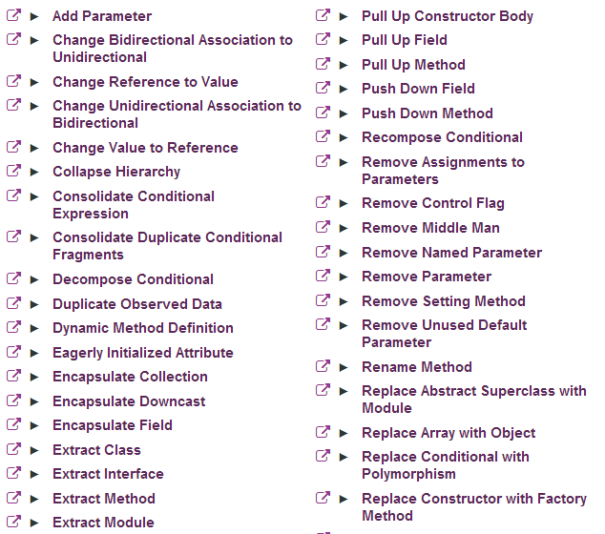
Refactoring Catalog

Slide 20
Mikado method
A change
We need to change this

Slide 21
Mikado method
A change
When we changed this

Slide 22
Mikado method
Prereq
A change
So it’s time to note all prerequisites

Slide 23
Mikado method
Prereq
Prereq
A change
So it’s time to note all prerequisites

Slide 24
Mikado method
Prereq
Prereq
A change
Prereq
So it’s time to note all prerequisites

Slide 25
Mikado method
Prereq
Prereq
A change
Prereq
When we tried refactor this

Slide 26
Mikado method
Prereq
Prereq
A change
Prereq
We’ve got new errors

Slide 27
Mikado method
Prereq
Prereq
Prereq
Prereq
A change
Prereq
Noted new prerequisites

Slide 28
Mikado method
Prereq
Prereq
Prereq
Prereq
A change
Prereq
And reverted again

Slide 29
Mikado method
Prereq
Prereq
Prereq
Prereq
A change
Prereq
Until we could do prerequisites without errors

Slide 30
Mikado method
Prereq
Prereq
Prereq
Prereq
A change
Prereq

Slide 31
Mikado method
Prereq
Prereq
Prereq
Prereq
A change
Prereq
Working the way back to original change

Slide 32
Mikado method
Prereq
Prereq
Prereq
Prereq
A change
Prereq
Now the change is easy to implement

Slide 33
Benefits of such approach
You always keep focus on target
Codebase every time is in good state
You won’t have such situation that time is go on and everything is broken

Slide 34
Refactoring strategies
Big Bang - Define the structure for the final state and push code to its ultimate home
Divide and conquer - Try to separate the big ball of mud into two pieces. Repeat until done...
Strangling

Slide 35
Why people like big bang?
We have to do a lot of changes we can’t divide problem into pieces
Strangling is very expensive, It’s cute but not for us
We don’t have tight schedule for this refactoring, let’s safely make a changes in branch
It’s a risky

Slide 36
Why do we need to refactor code ?
Did you face with such term as “Risky change” ?

Slide 37
What information is hidden?
From practical standpoint big bang never happens successfully

Slide 38
Agenda
Refactoring strategies
Summary
Case study
Why do we change code?
Why to refactor workable code?

Slide 39
Case study
What refactor strategy should be used ?
Big Bang - Define the structure for the final state and push code to its ultimate home
Divide and conquer - Try to separate the big ball of mud into two pieces. Repeat until done...
Strangling

Slide 40
We used mixed
Divide and conquer - Try to separate the big ball of mud into two pieces. Repeat until done...
Strangling

Slide 41
Refactoring taxonomy
Create infrastructure to switch implementations
Utilize dependency injection
Guarantee that we have reliable mechanism to check that everything works
Finish refactoring (divide and conquer)

Slide 42
Guarantee that we have reliable mechanism to check that everything works
Initiated integration tests
UI automation tests check that everything is verified
Unit tests: create necessary coverage and verifications for authentication/authorization flows
Don’t forget about concurrent scenarios

Slide 43
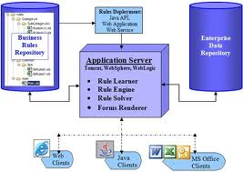
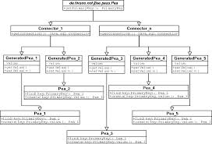
Create infrastructure: gather old structure
Application
Session context
Security Old code structure

Slide 44
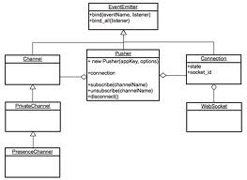
Create infrastructure: Create new structure
Application
Security Old
Security New Adapter
35% of deal ☺

Slide 45
Utilize Dependency Injection
Servlet session context
Security Old classes
(Current implementation)
Adapter classes
Application Code
Adapter API
Interfaces only
Security New classes (implemented in v2 package)
Spring managed context
Security Old (application context)
Security New (application context
New application boundaries
Old Application boundaries
Switch (web.xml)

Slide 46
Finish refactoring: make new Security workable
Application Code
Adapter API
Interfaces only
Security New classes (implemented in v2 package)
Spring managed context
Security New (application context
New application boundaries
Switch (web.xml)

Slide 47
Finish refactoring drop old code
Servlet session context
Security Old classes
(Current implementation)
Adapter classes
Application Code
Adapter API
Interfaces only
Security Old (application context)
Old Application boundaries
Switch (web.xml)

Slide 48
Summary
Please don’t believe in risk
Write code that doesn’t require further refactoring
In case you need to refactor a large project please think 10 times before doing this.

Slide 49
Write code to have your house in good state

Slide 50
Useful Links
Refactoring Large Software Systems
Michael C. Feathers Working efficiently with legacy code
Refactoring legacy applications
Large scale refactoring

Slide 51
Questions

